Slide 1
Nuclear effects in the optically-detected magnetic resonance of electron spins in n-GaAs
  Benjamin Heaton
  John Colton
  Brigham Young University

Slide 2
Outline
1) Background
2) Overhauser Coupling and DNP
3) Control of Nuclear Effects
4) Modified ODENDOR Method and Results
5) Quantum well sample
6) Oscillations in spin polarization

Slide 3
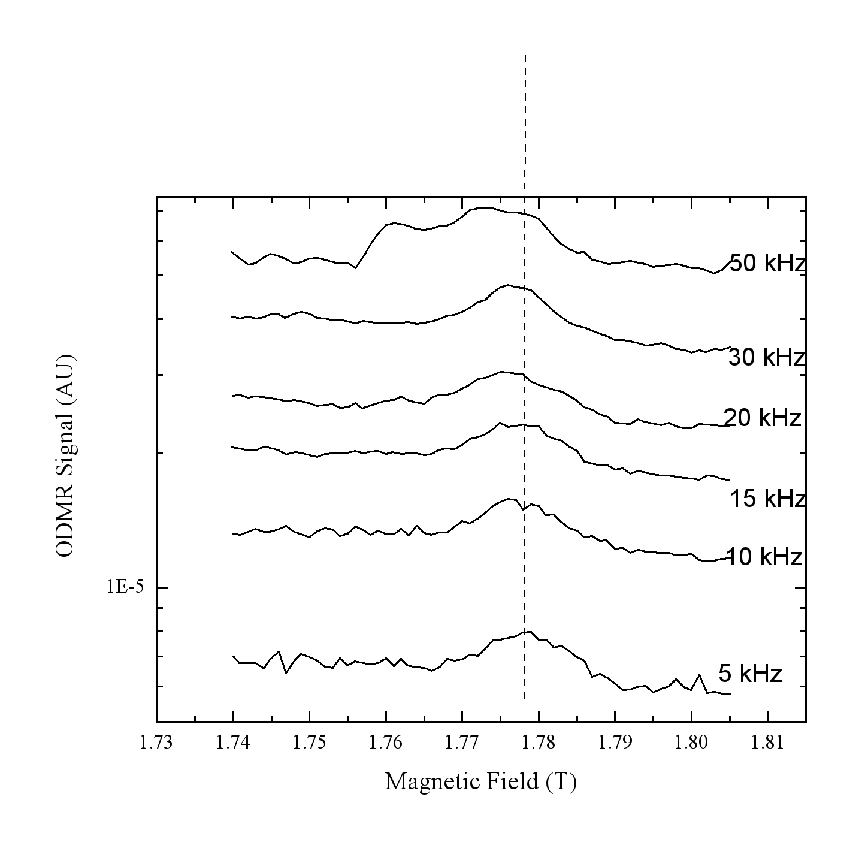
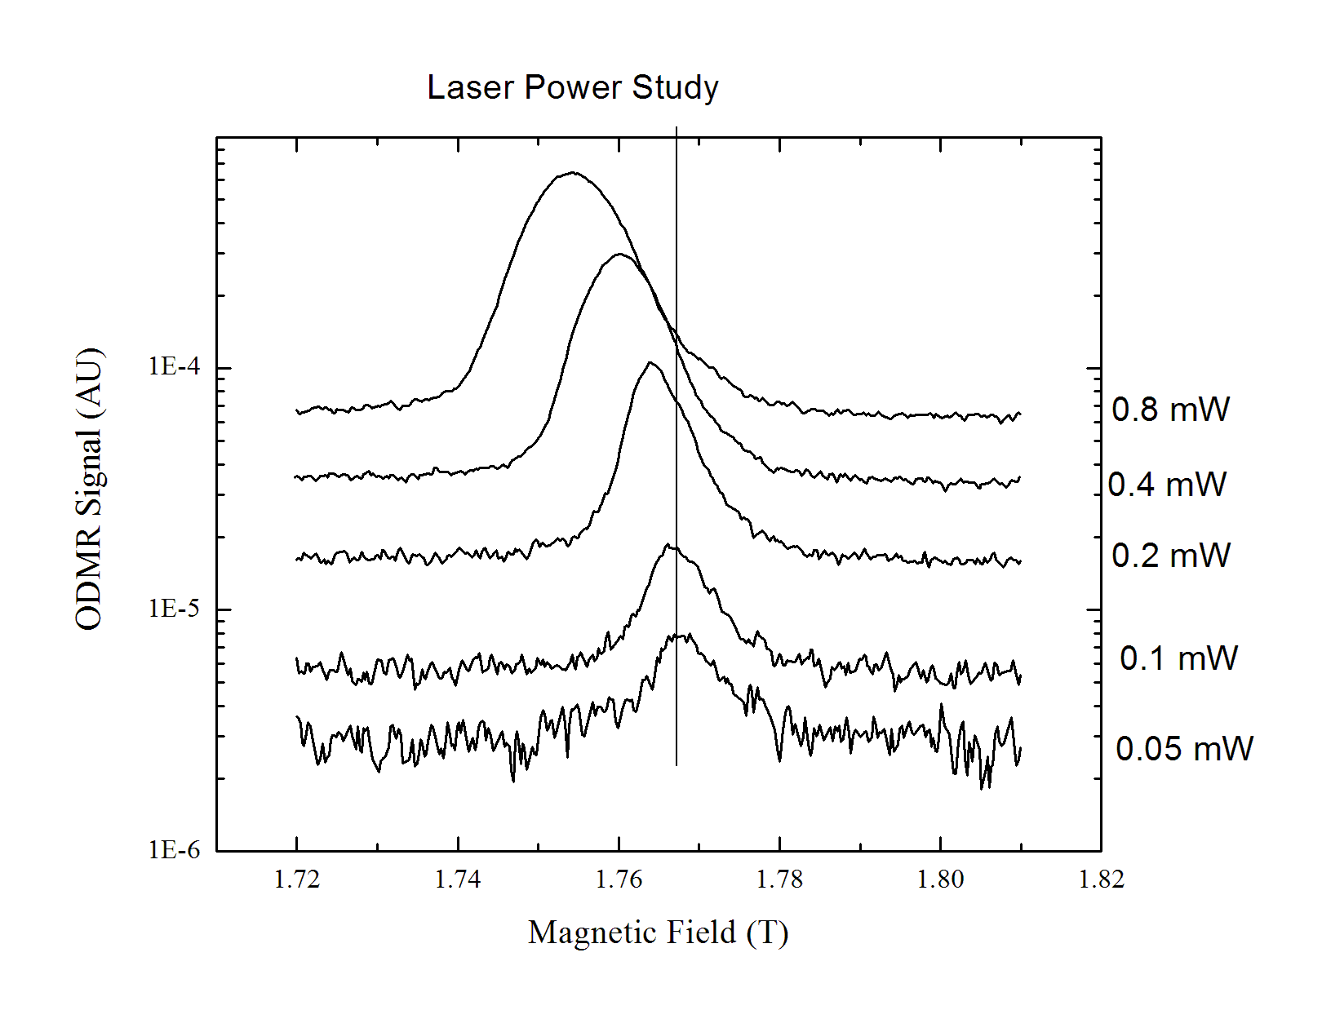
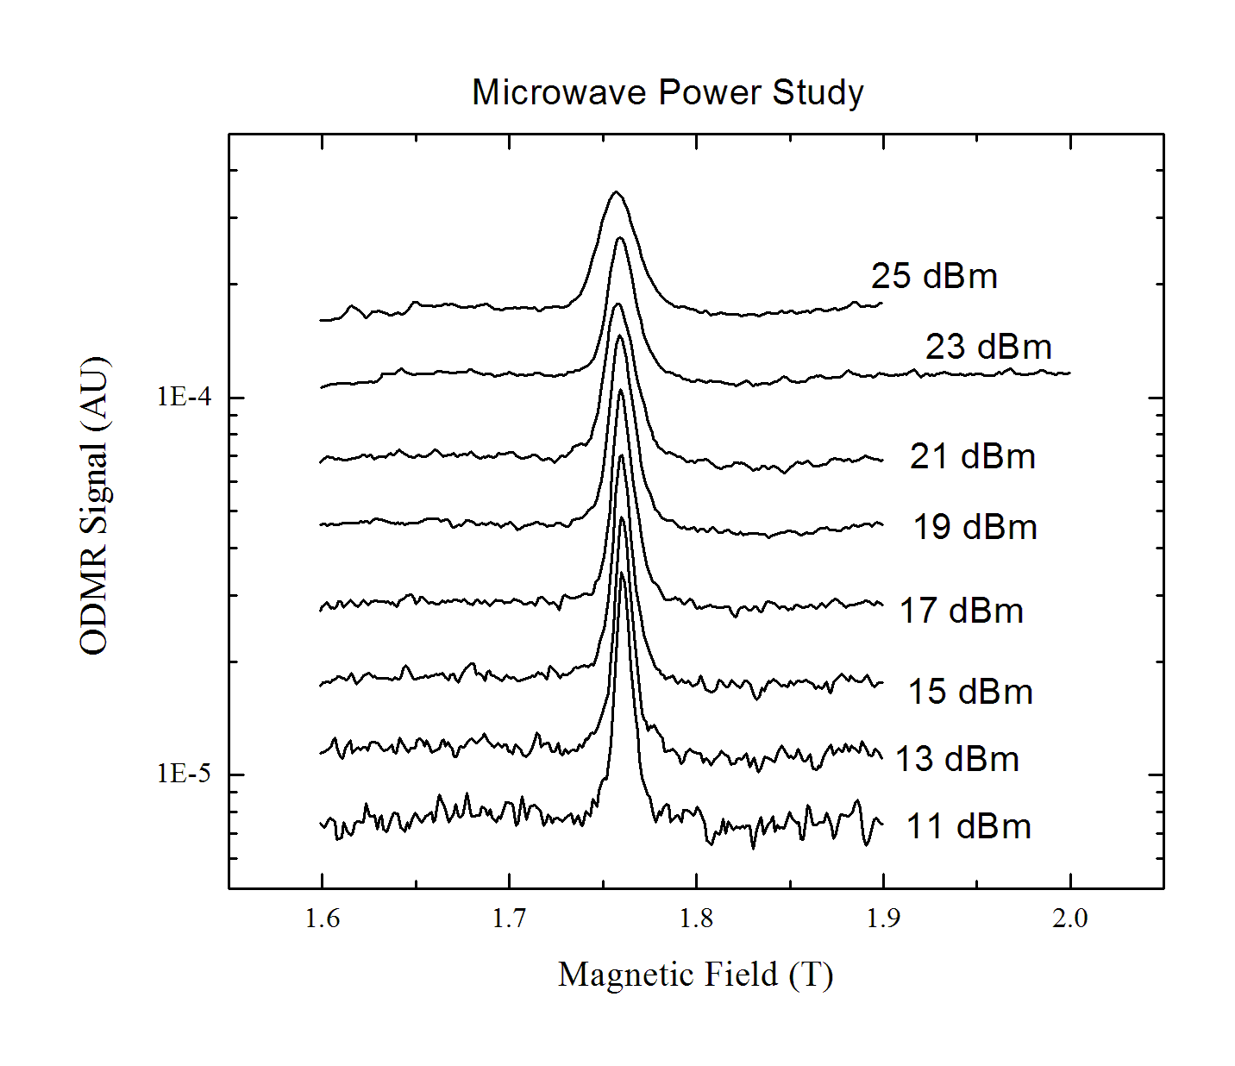
Overhauser effect causes broadening and shifting of the ODMR peak
Increasing Average μ-wave Power
Resonance Conditions
Electron
polarization
changes
Nuclear
polarization
changes
“Bulk” = 3E14 n-GaAs
“QW” = 3e12, 14nm well
Increasing Laser Power
Increasing ESR μ-wave Power

Slide 4
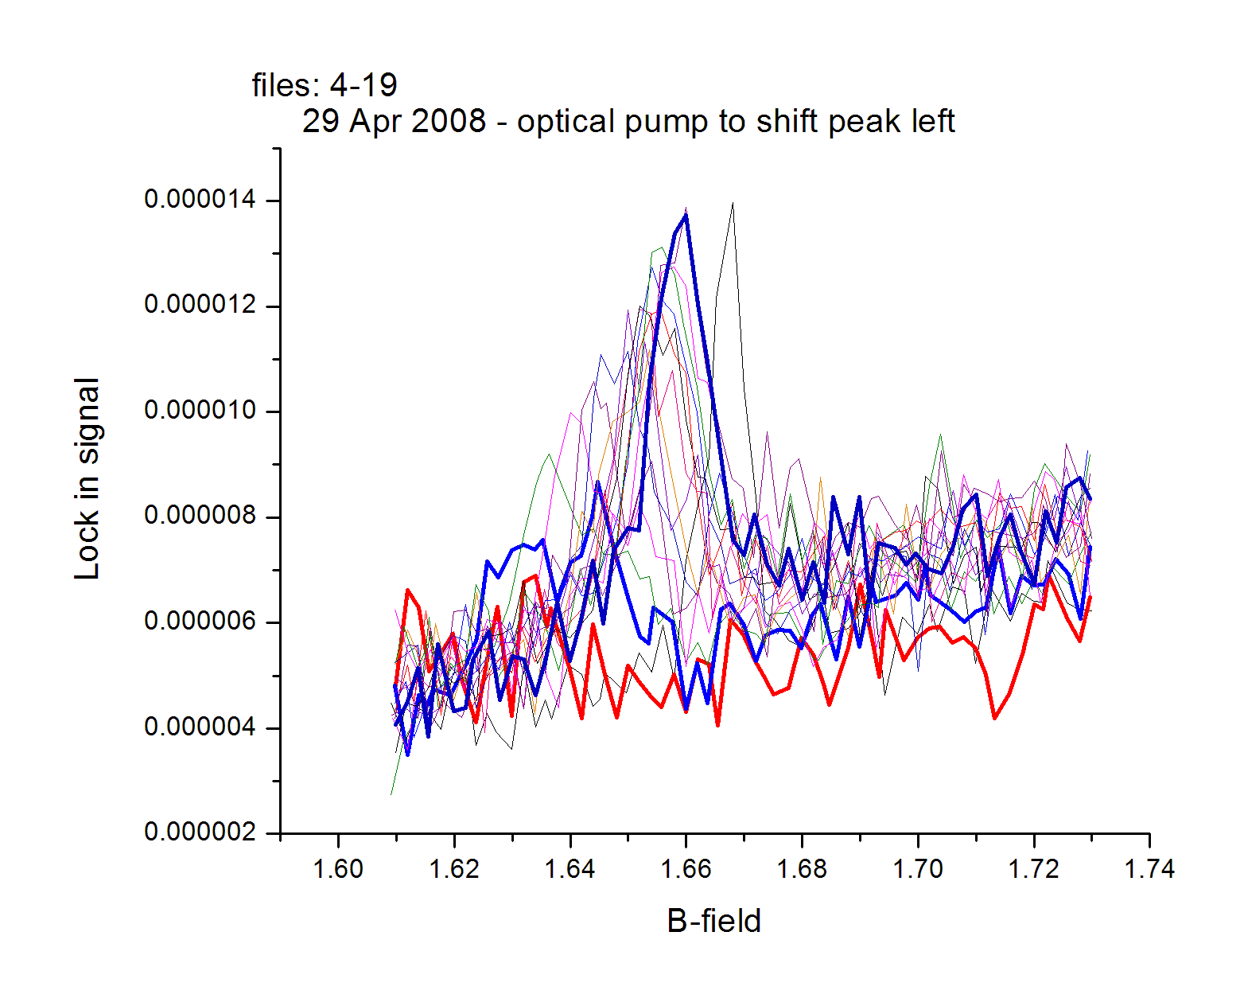
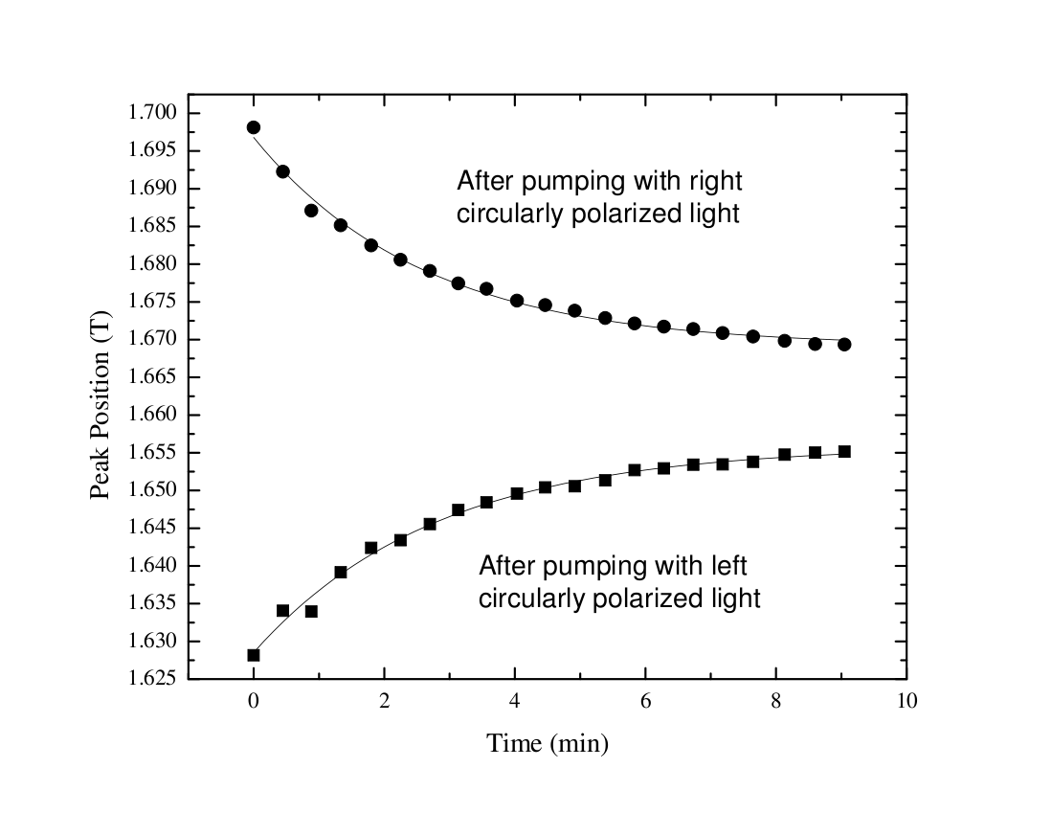
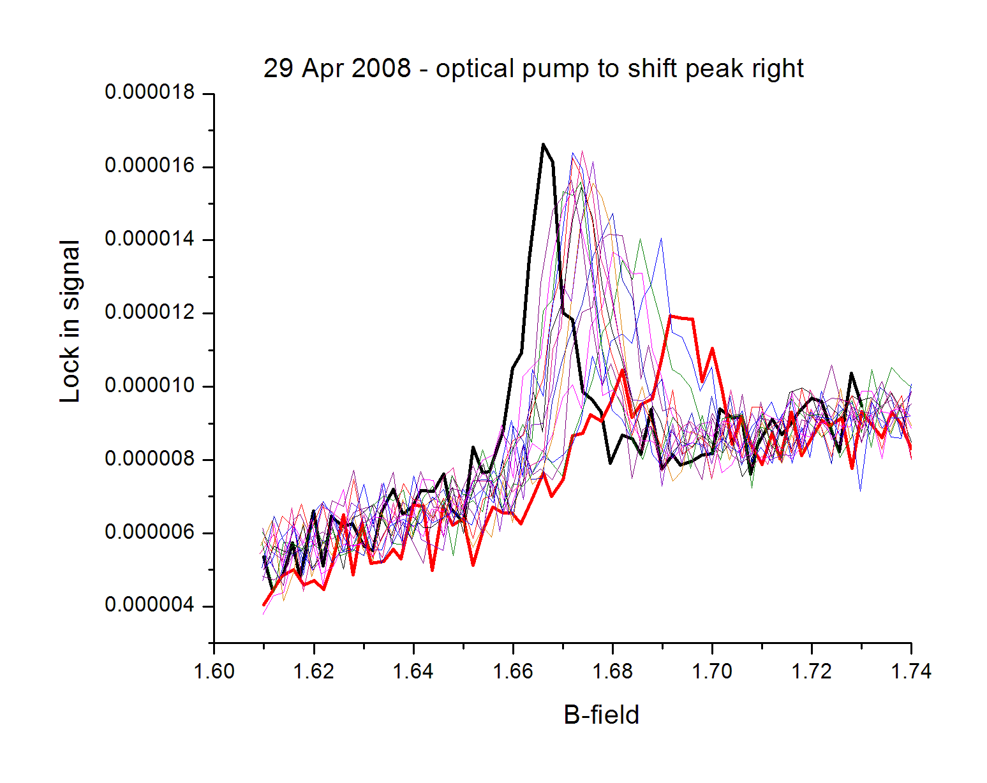
Nuclear relaxation time
Time
Time
Nuclear spin has a lifetime of 2.3 minutes

Slide 5
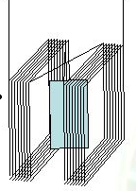
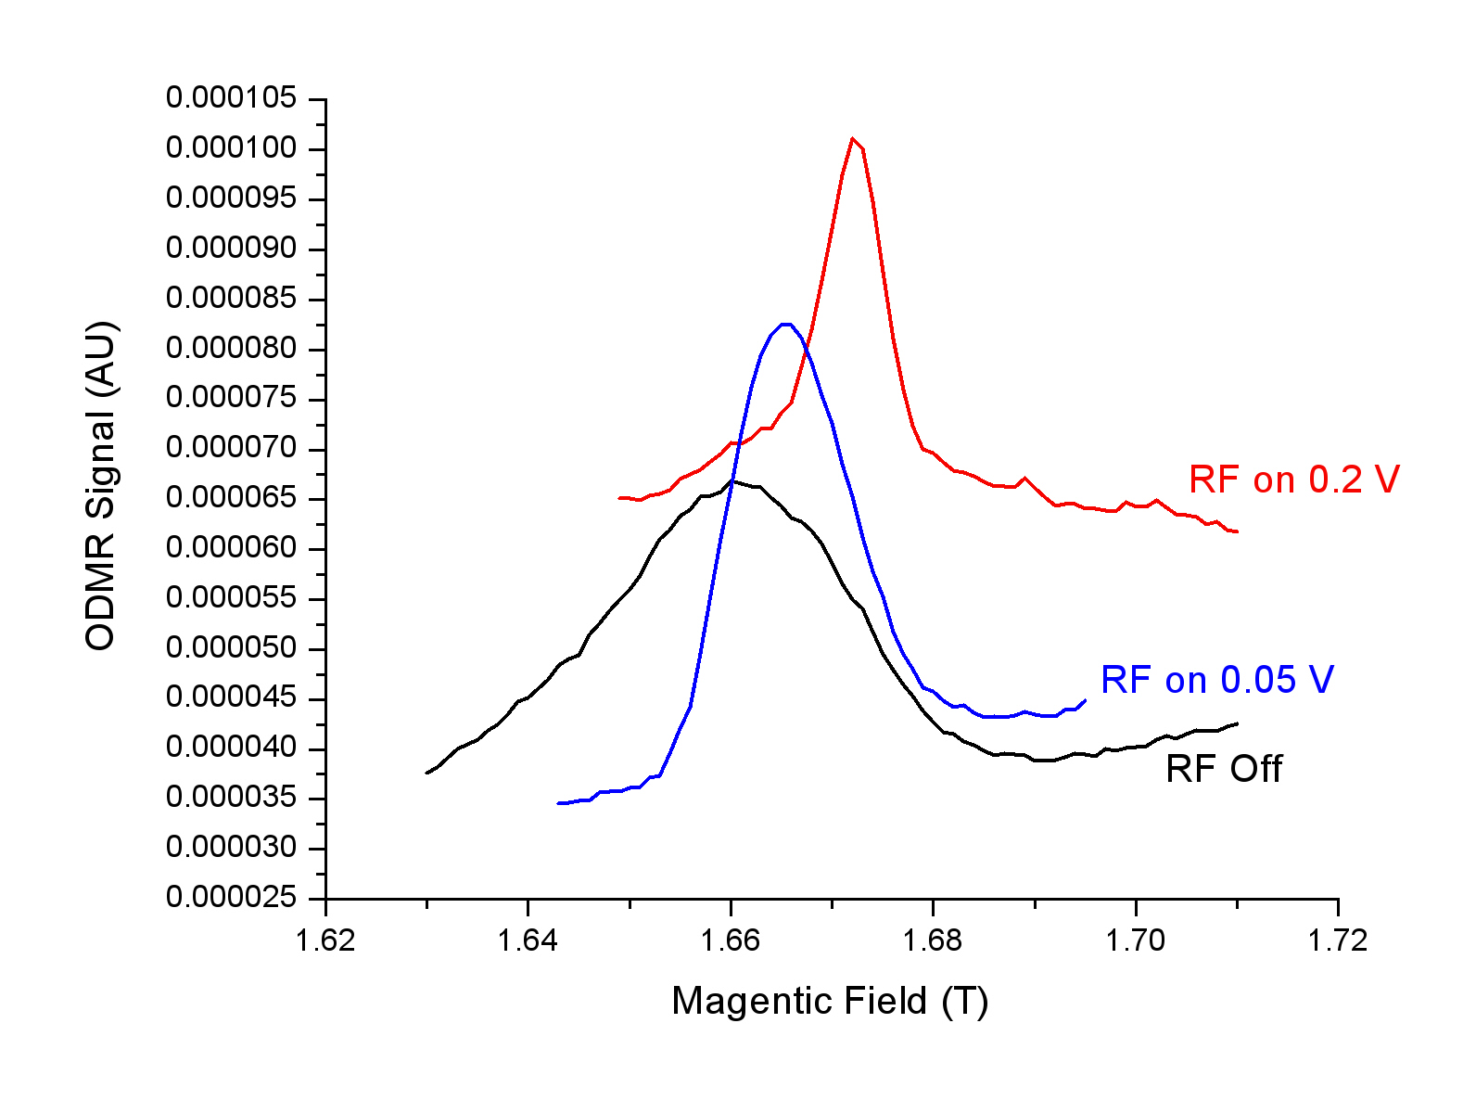
NMR coils
Split Helmholtz coil
creates oscillating
magnetic field at NMR
frequencies
Resonated nuclei
have zero net
polarization
Take off numbers
DNP is eliminated

Slide 6
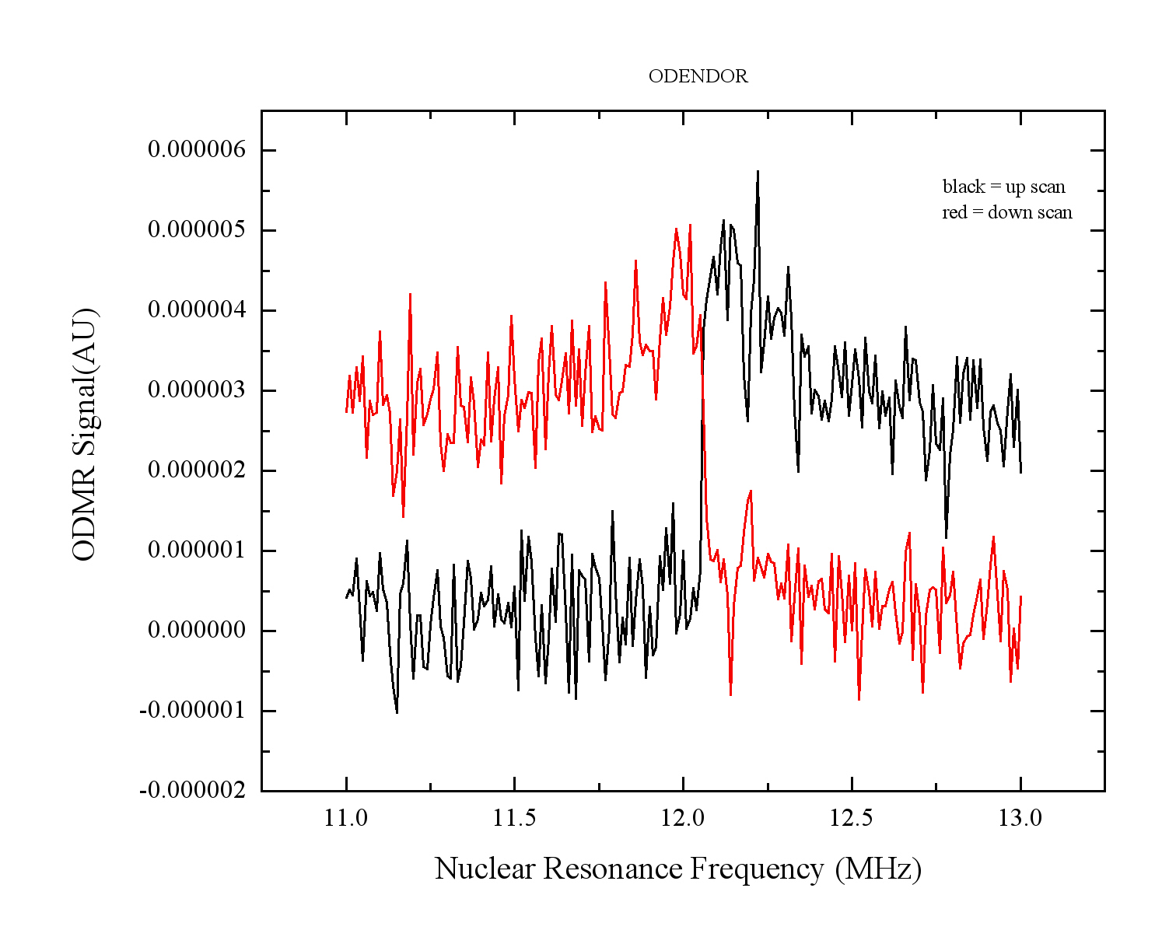
Modified ODENDOR on two Ga isoptopes and ⁷⁵As
Although no new information is gained through
this process, this new method of measuring
nuclear spin resonance is shown to be viable.
More importantly,
we have complete
control over DNP!
1) Resonate two of the three nuclei
2) Monitoring ODMR peak
3) Stepping through the third nuclei.
⁷⁵As Nuclei
Nuclear resonance
peak is very narrow!
10KHz
and pushing the
limits of our sensitivity

Slide 7
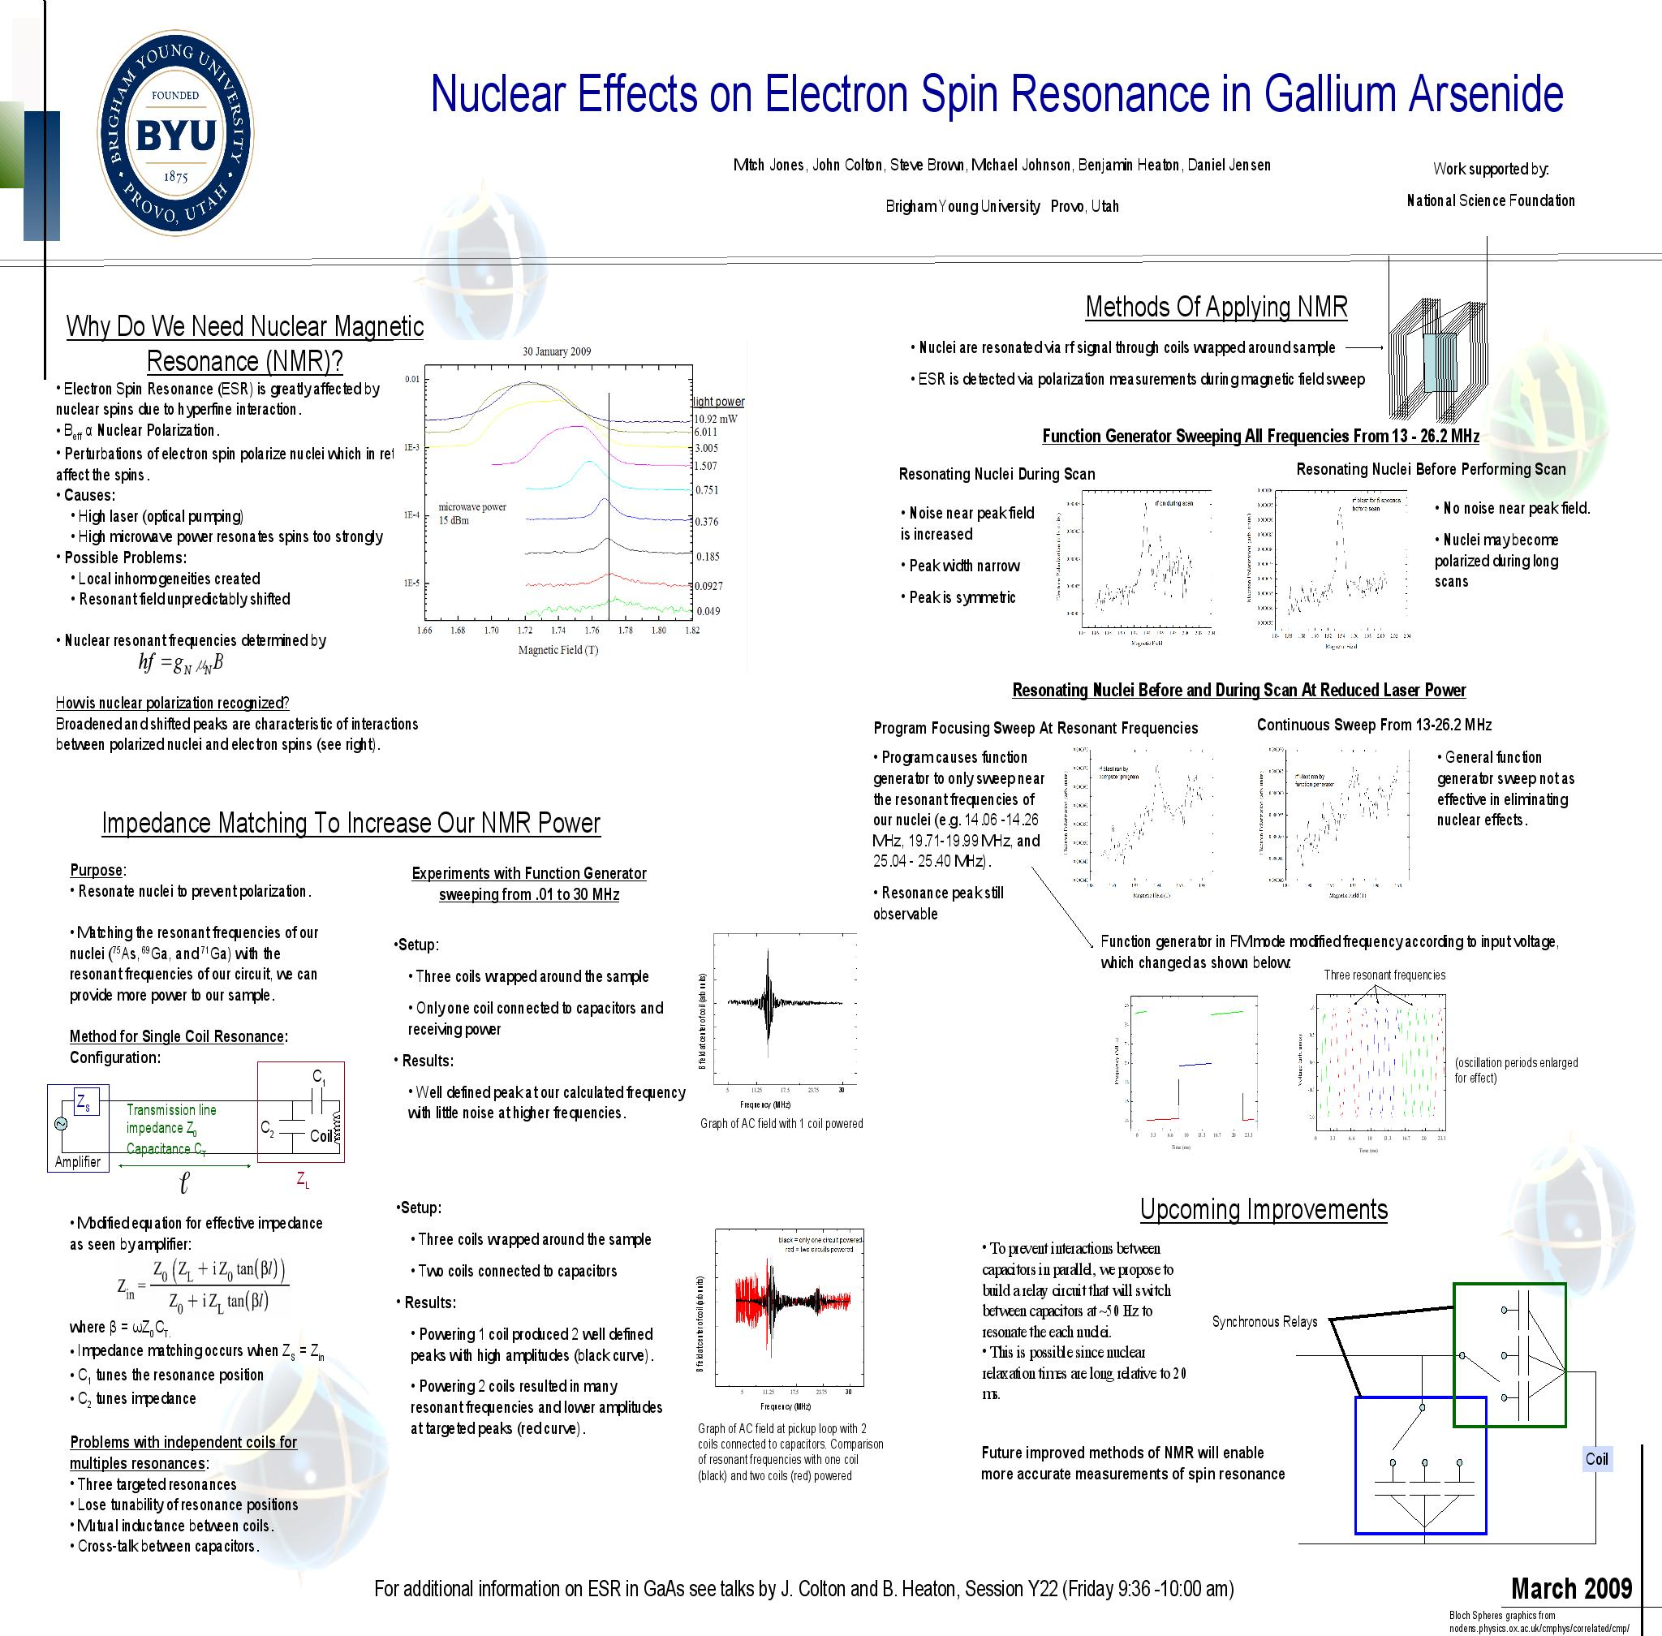
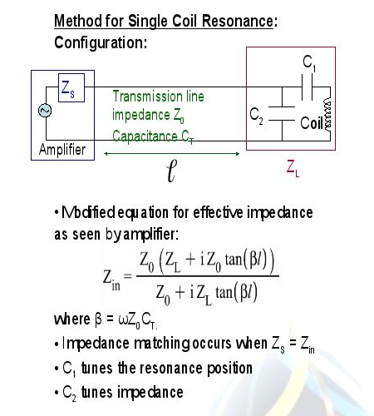
Not really “complete” control:
(two competing effects)‏
DNP vs. Resonating field
of our Helmholtz coil
B = (n*I)/R
Good News: Quantum well
sample has less Overhauser
coupling.

Slide 8
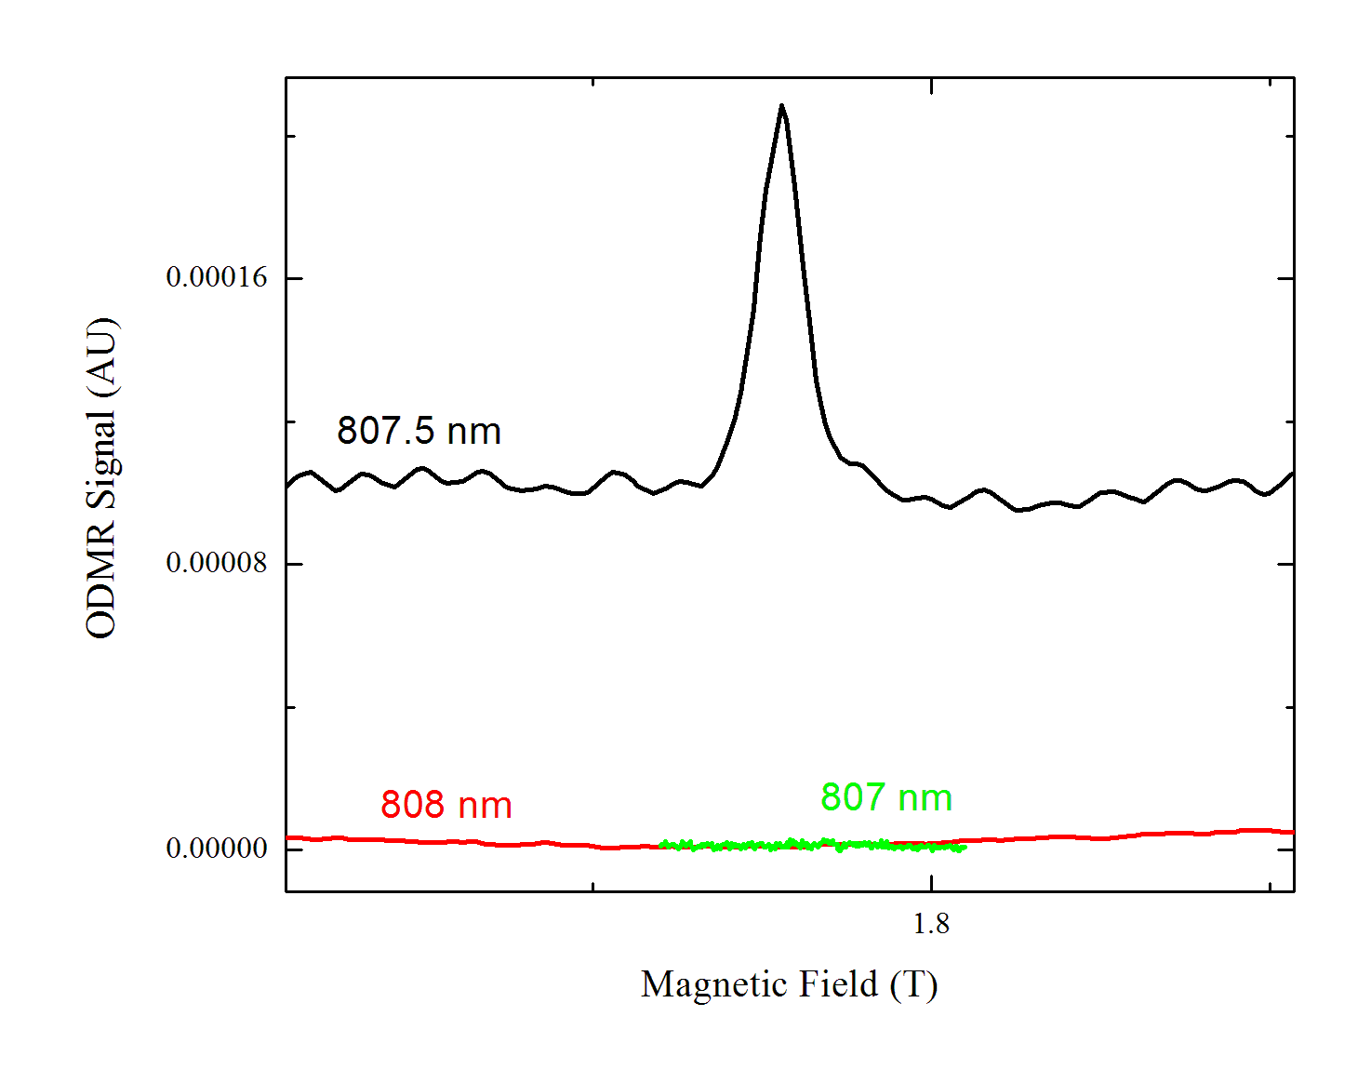
Sensitivity to wavelength
Similar samples have been
studied with pulsed lasers.
Our CW laser has narrow enough
bandwidth to see wavelength
dependence
This frequency
dependence was not
seen in the bulk GaAs sample

Slide 9
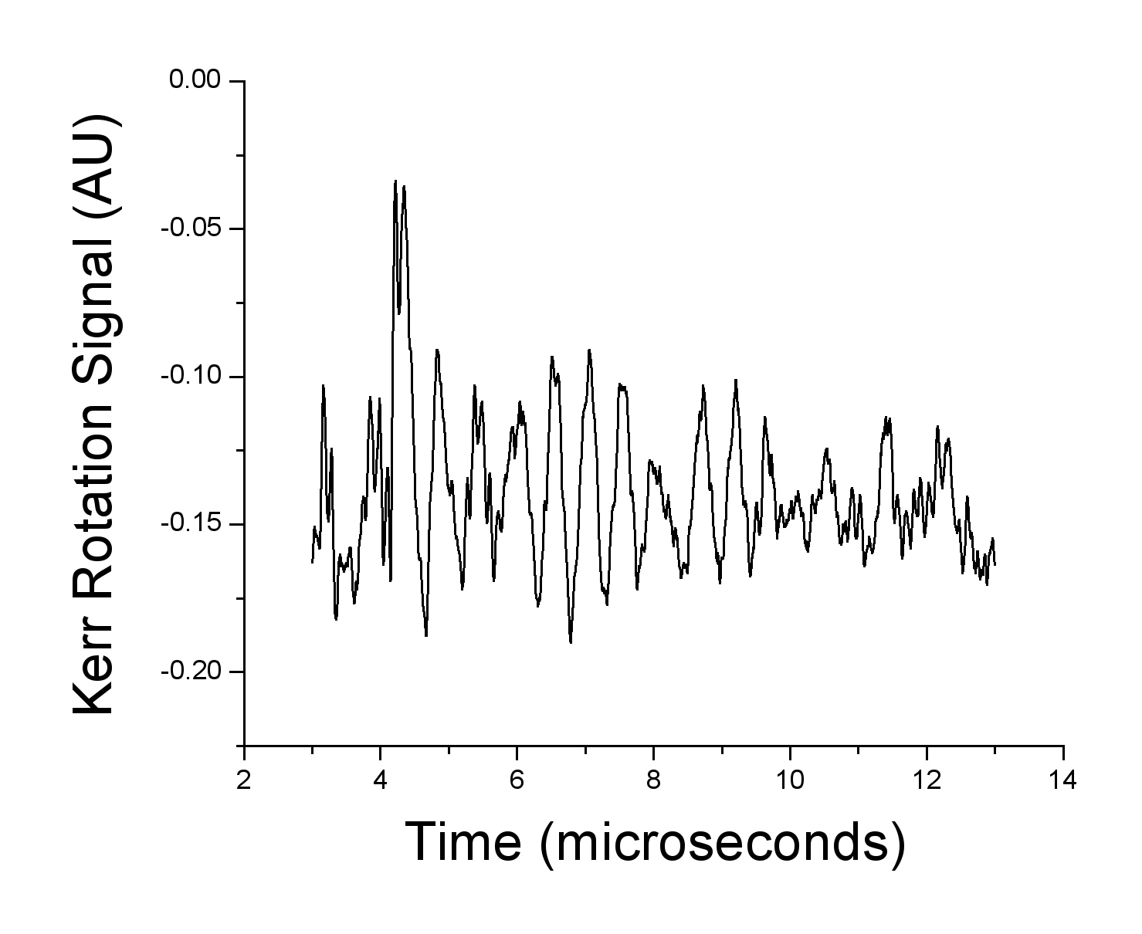
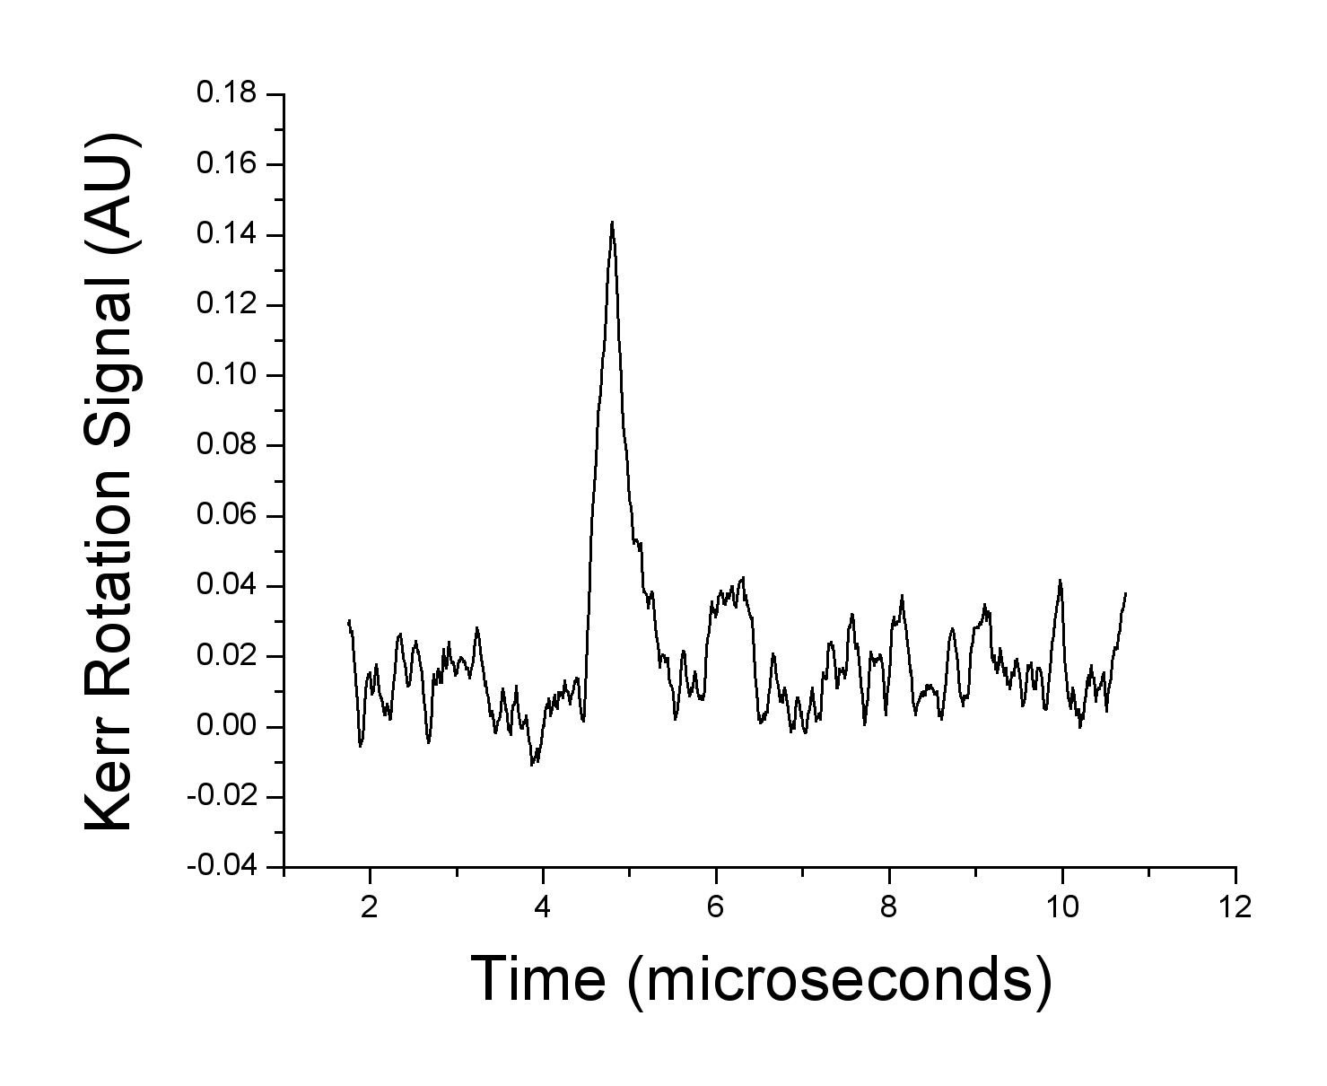
Spin Oscillations
Bulk Sample
Quantum Well Sample
Microwaves turn on
Microwaves turn on
Long T₁≈ 50 μs
Short T₁≈ 200ns

Slide 10
Probably not Rabi flopping:
Definitely due to oscillations in spin polarization
Turns on and off with the electron spin resonance conditions
Oscillations present at 1.5K, but not at 5K
Doesn't have the correct dependence on field to be coherent
precession
Doesn't have the correct
dependence on ESR
power to be Rabi
oscillations

Slide 11
Conclusion
We can control the DNP (within certain limits)‏
Modified ODENDOR method works
We see unexplained spin state oscillations
Compare QW and bulk GaAs samples
Bulk Sample
Strong Overhauser Coupling
Insensitive to probe wavelength
Long T1
T2* = 20 ns
Quantum Well Sample
Weak Overhauser Coupling
Very sensitive to probe wavelength
Short T1
T2* = 6 ns
Thanks to:
John Colton and his lab group, Mitch Jones, Steve Brown, Michael Scott
Tom Kennedy, NRL for useful discussions
Berry Jonkers, NRL for the samples
NSF for funding

